Slide 1

1.30pm, 27 October, Incremental Group

Slide 2
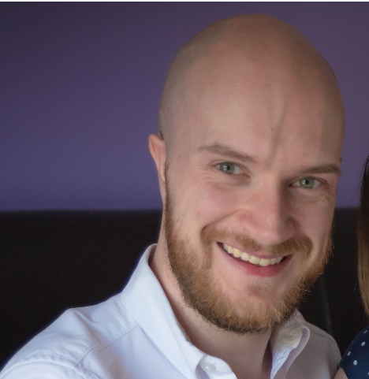
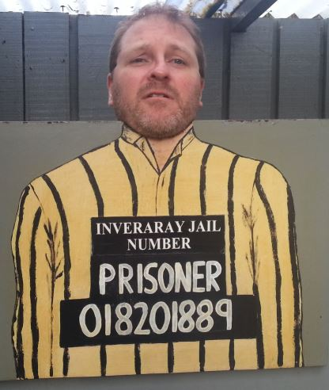




ABOUT US
Craig
Porteous
Paul
Broadwith
Data Engineer @ Incremental Group
Worked in BI with the Microsoft stack for more than 10 years.
SQL Glasgow UG co-leader. SQLGLA Creator.
Senior Technical Engineer @ Chocolatey Software
25 years in IT in the defence, government, financial services and nuclear industry sectors.
Scottish PowerShell & DevOps User Group Founder.
https://craigporteous.com
@cporteous
https://github.com/cporteou
https://www.linkedin.com/in/craigporteous/
pauby.com
@pauby
github.com/pauby
linkedin.pauby.com
Notes:
Feel free to interrupt us at any point with questions.

Slide 3
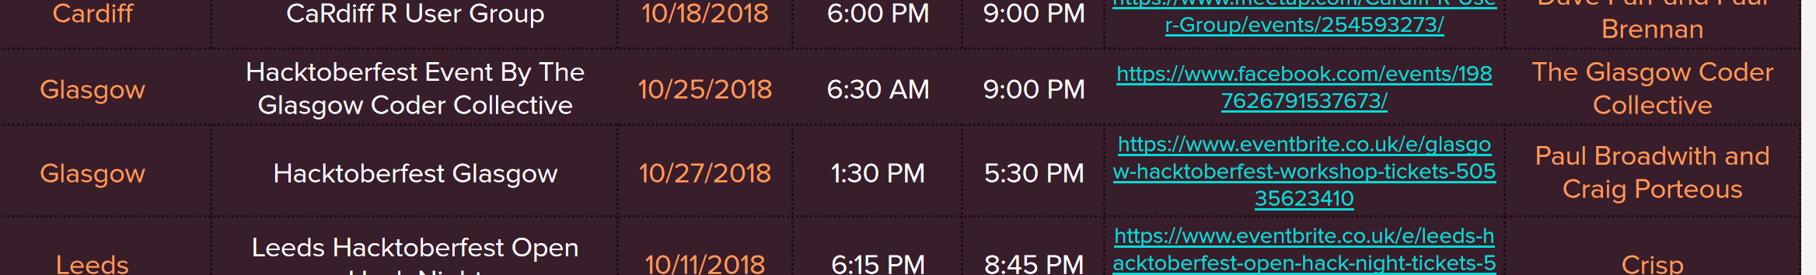
AGENDA
Git Fundamentals Talk
Do’s & Don’ts Of Open Source Contributing
First Pull Request
Let Loose On Pull Requests

Slide 4
SKYPE CHANNEL
https://meet.lync.com/incrementalgroup.co.uk/craig.porteous/5K0H237G

Slide 5
CODE OF CONDUCT
See Skype Channel
https://docs.google.com/document/d/ 1gFKOhyUqMZzrZcbq8A_TpO5x9J9HK6agv70awCH8pyI

Slide 6
PowerShell
AWS
Module Design
Intune
DSC
Best Practice
SQL
SharePoint
OMS
Started May 2017
19 Talks
16 Unique Speakers
13 Meetups
2 Workshops
Standards
Git
Azure
.NET
WinOps
DevOps
Scotland
Missouri
Netherlands
Germany
England
Belgium
Nebraska
Sweden
Massachusetts
New Zealand

Slide 7




SCOTTISH POWERSHELL
AND DEVOPS USER GROUP
psdevopsug.scot
@scotpsug
meetup.psdevopsug.scot

Slide 8



SQL Server
Power BI
Data Analytics
Business Intelligence
Data Warehousing
PowerShell
Azure
@SqlGlasgow
Bit.ly/sqlglasgowlinkedin
Bit.ly/sqlglasgow

Slide 9

Coming
September
2019

Slide 10

QUESTIONS?
https://24pullrequests.com/
Notes:
24 Pull Requests encourages you to make one pull request each day during December
Hacktoberfest encourages you to make 5 pull requests during October

Slide 11



Craig Porteous
Paul Broadwith
craigporteous.com
@cporteous
github.com/cporteou
linkedin.com/in/craigporteous
pauby.com
@pauby
github.com/pauby
linkedin.pauby.com
pau.by/hacktoberfest

